Slide 1
Book of Revelation (Churches)
Pearl Patch Bible Study – Tuesday, January 14, 2020

Slide 2
Prayer
Father, we are asking that You give us wise minds and spirits attuned to Your will, and so that we acquire a thorough understanding of the ways in which You work. In Jesus Name. -Amen!

Slide 3
Focus
Keyword: Revelation
Revelation translate the Greek word apokalypsis, an unveiling or disclosing of a reality that previously has not been perceived.

Slide 4
The Seven Churches of the Apocalypse
Church | Condition
Ephesus (2:1 – 7) | The Loveless Church
Smyrna (2:8 – 11) | The Persecuted Church
Pergamos (2:12 – 17) | The Compromising Church
Thyatira (2:18 – 29) | The Corrupt Church
Sardis (3:1 – 6) | The Dead Church
Philadelphia (3:7 – 13) | The Faithful Church
Laodiceans (3:14 – 22) | The Lukewarm Church

Slide 5
Follow-Up Study Question:
How Balaam and Balak had so much influence on the people to lead them astray?
Where did they get this power?
Background Scriptures: Numbers 22-24

Slide 6
THE SEVEN CHURCHES OF THE APOCALYPSE (1:20)
Church | Condition | Commendation | Criticism | Instruction | Promise
Ephesus (2:1-7) | The Loveless Church | Rejects evil, perseveres, has patience | Love for Christ no longer fervent | Do the works you did at first | The Tree of Life
Smyrna (2:8-11) | The Persecuted Church | Gracefully bears suffering | None | Be faithful until death | The crown of life
Pergamos (2:12-17) | The Compromising Church | Keeps the faith of Christ | Tolerates immorality, idolatry, and heresies | Repent | Hidden manna and a stone with a new name
Thyatira (2:18-29) | The Corrupt Church | Love, service, faith, patience is greater than at first | Tolerates cult of idolatry and immorality | Judgment coming; keep the faith | Rule over nations and receive morning star
Sardis (3:1-6) | The Dead Church | Some have kept the faith | A dead church | Repent; strengthen what remains | Faithful honored and clothed in white
Philadelphia (3:7-13) | The Faithful Church | Perseveres in the faith | None | Keep the faith | A place in God's presence, a new name, and the New Jerusalem
Laodiceans (3:14-22) | The Lukewarm Church | None | Indifferent | Be zealous and repent | Share Christ's throne

Slide 7
Special Presentation Rick Renner Ministries

Slide 8
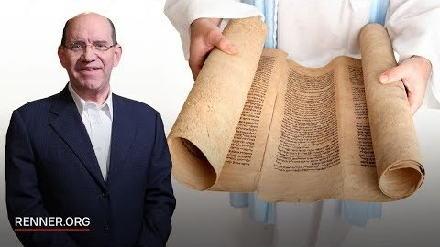

Slide 9
What are your Thoughts?
What are some of the ways you feel pressured to modify the faith?

Slide 10
Hope
I keep my eyes always on the Lord. With him at my right hand, I will not be shaken.
- Psalms 16:8

Slide 11
?
QUESTIONS
&
PRAYER REQUESTS

Slide 12
Closing Prayer
Thank you, Father, for giving us wise minds and spirits attuned to Your will, that we may continue to acquire a thorough understanding of the ways in which You work (and Your purpose for our lives). In Jesus Name. -Amen!
Modified from Colossian 1:9 (MSG – emphasis mine)

